Slide 1

Exception Handling and Searching
(ST4000CEM) PROGRAMMING AND ALGORITHM
Team Members
Prakriti Chapai
Jesika Dhamala
Sushmita Pandey
Swastika Dhungana
Submitted To
Mr. Giri Raj Rawat
JD

Slide 2

Exception
An exception is an event which occurs during the execution of a program, that disrupts the normal flow of the program's instructions.

Slide 3
Types of Exceptions
Syntax Errors
Logical Errors
Runtime Errors (Exceptions)
Syntax error occurs when the interpreter shows invalid syntax on executing the python code.
A logical error occurs in a python when the code runs without any syntax or runtime error but produces incorrect results due to flawed logic in the code.
A runtime error is a type of error that occurs during program execution.

Slide 4
Types of Runtime Errors
1
Value Errors
2
Index Errors
3
File Errors
Value errors occur when a function receives an argument of the correct data type but an inappropriate value.
Index errors occur when you try to access an element in a sequence (like a list or string) using an index that is out of range.
File errors occur when there is a problem with reading or writing to a file, such as trying to open a file that doesn't exist or trying to write to a file that is read-only.
4
Import Errors
5
Key Errors
Import errors occur when Python cannot find or load a module that you are trying to import.
Key errors occur when you try to access a key in a dictionary that doesn't exist.

Slide 5

User-Defined Exceptions
Exceptions created by programmers.
User-defined exceptions in Python are custom error classes that you create to handle specific error conditions in your code.
Raise keyword/statement: An exception can be raised forcefully by using the raise clause in python. Raise statement is used when we want to throw exception for particular condition.
Syntax:- raise ExpectationName("exception message")
Assert Statement:
It is used to test an expression in the program code. The assert keyword lets you test if a condition in your code returns True, if not, the program will raise an Assertion error.
Syntax:- assert Expression[,arguments]

Slide 6

Exception Handling
Exception handling is similar like debugging where its main role is to identify and addressing the errors in Code to make the code run smoothly and more reliably.

Slide 7





How Exception Handling Works
TRY BLOCK
TRY BLOCK IS A MANDATORY PART OF EXCEPTION HANDLING WHERE WE CAN TEST SPECIFIC PART OF CODE TO IDENTIFY THE POSSIBLE ERRORS.
EXCEPTION BLOCK
EXCEPTION BLOCK IS USED AFTER A TRY BLOCK TO CATCH AND HANDLE THE EXCEPTION . IT IS EXEUTED WHEN AN ERROR IS OCCUR IN THE TRY BLOCK.IT HELPS TO PREVENT THE PROGRAM FROM CRASHING.
ELSE BLOCK
ELSE BLOCK IS INITLATED WHEN NO ERROR IS FOUND IN TRY BLOCK AND IT IS A OPTIONAL PART.
FINALLY BLOCK
FINALLY BLOCK IS NOT MANDATORY AND IT IS EXECUTED A;WAYS WHETHER THE CODE IN TRY BLOCK FIND AN ERROR OR NOT.

Slide 8

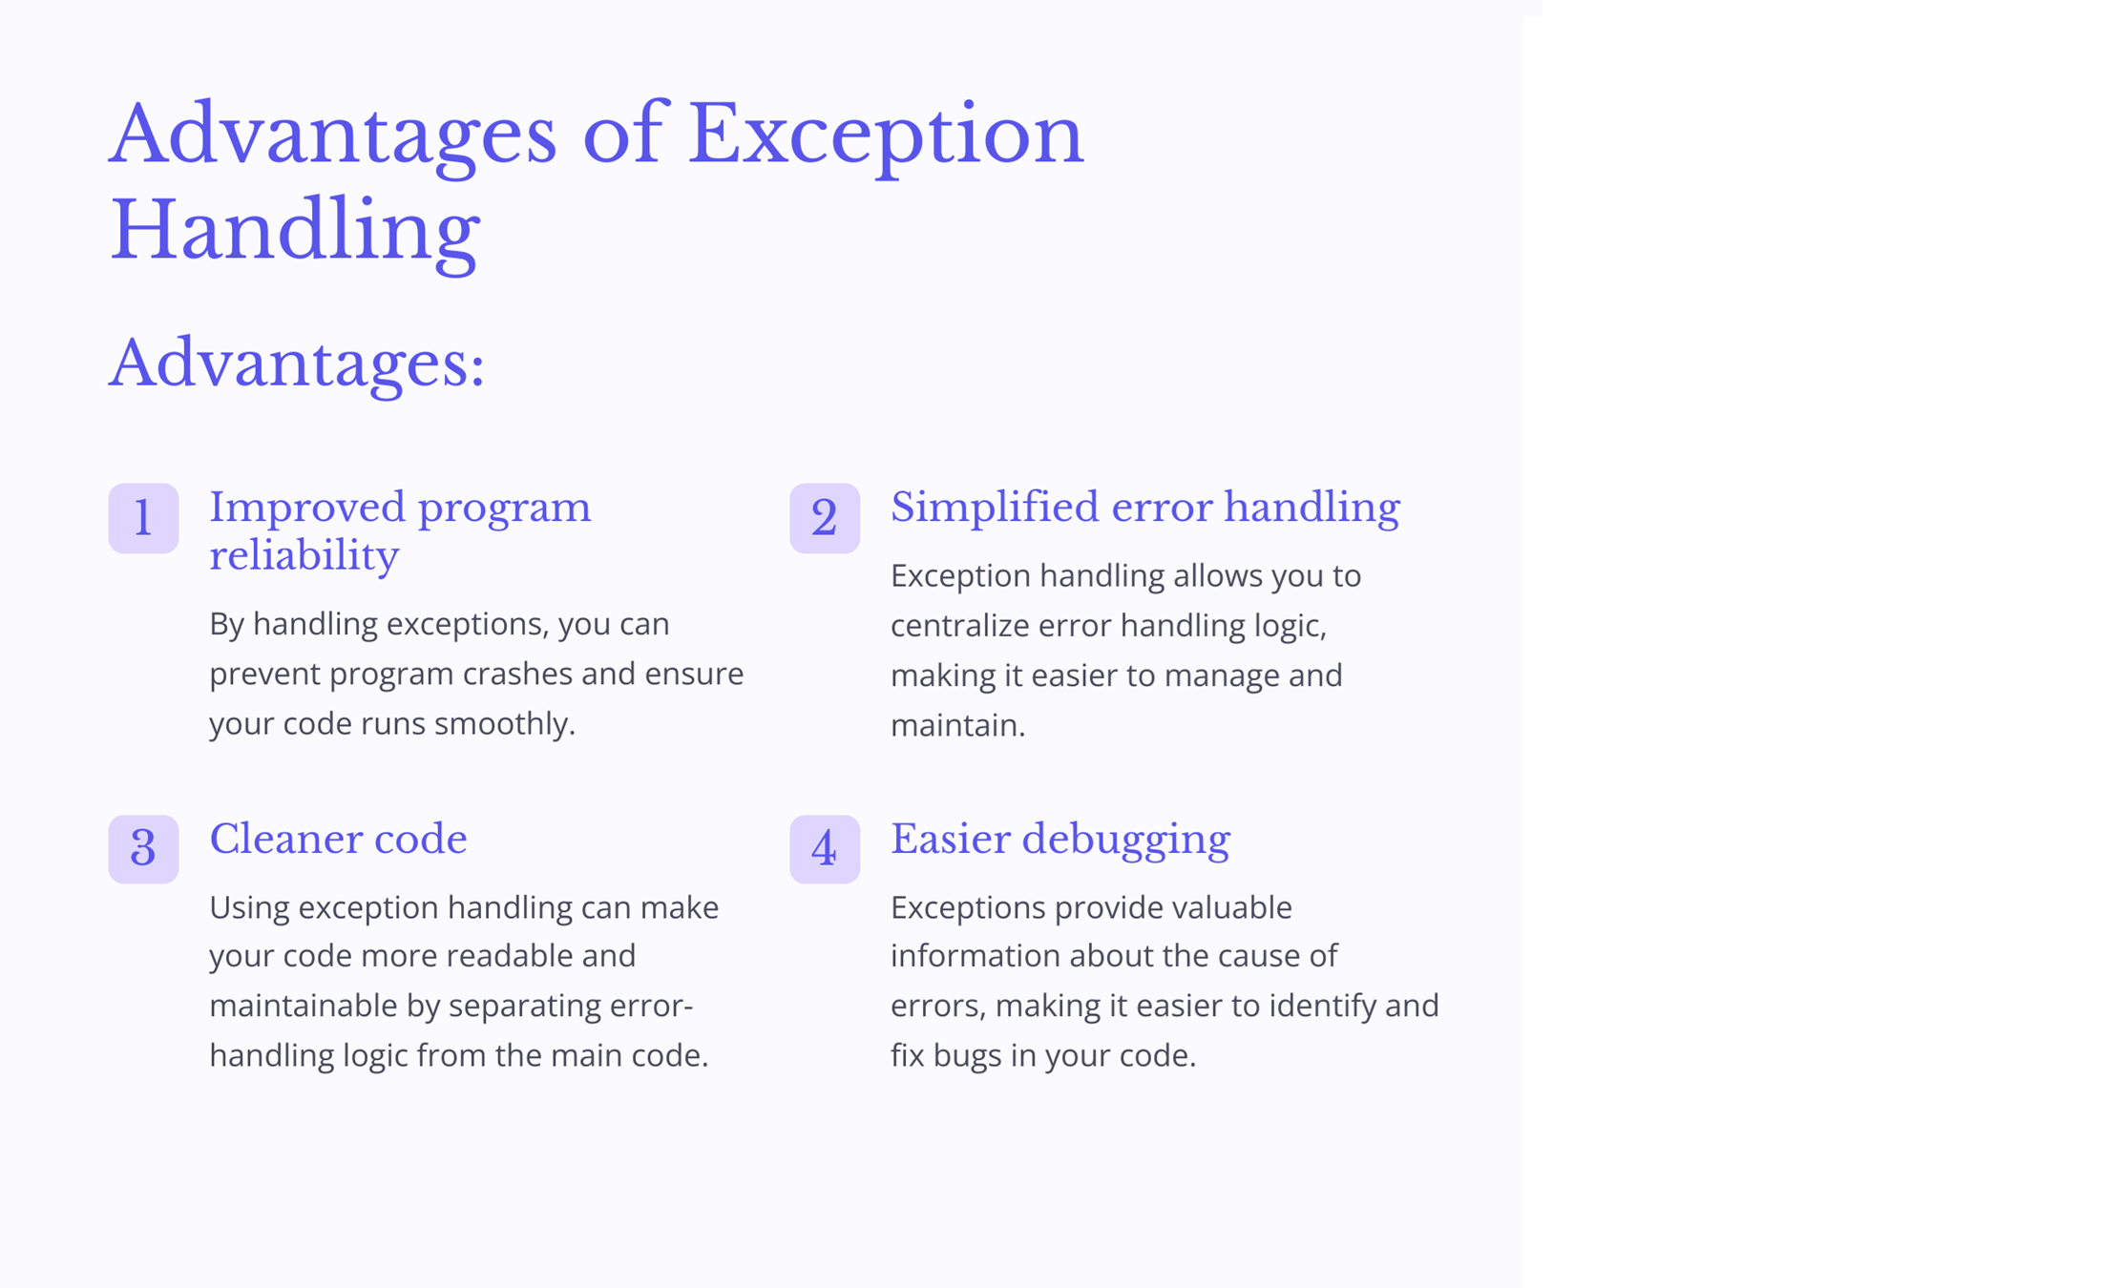

Slide 9

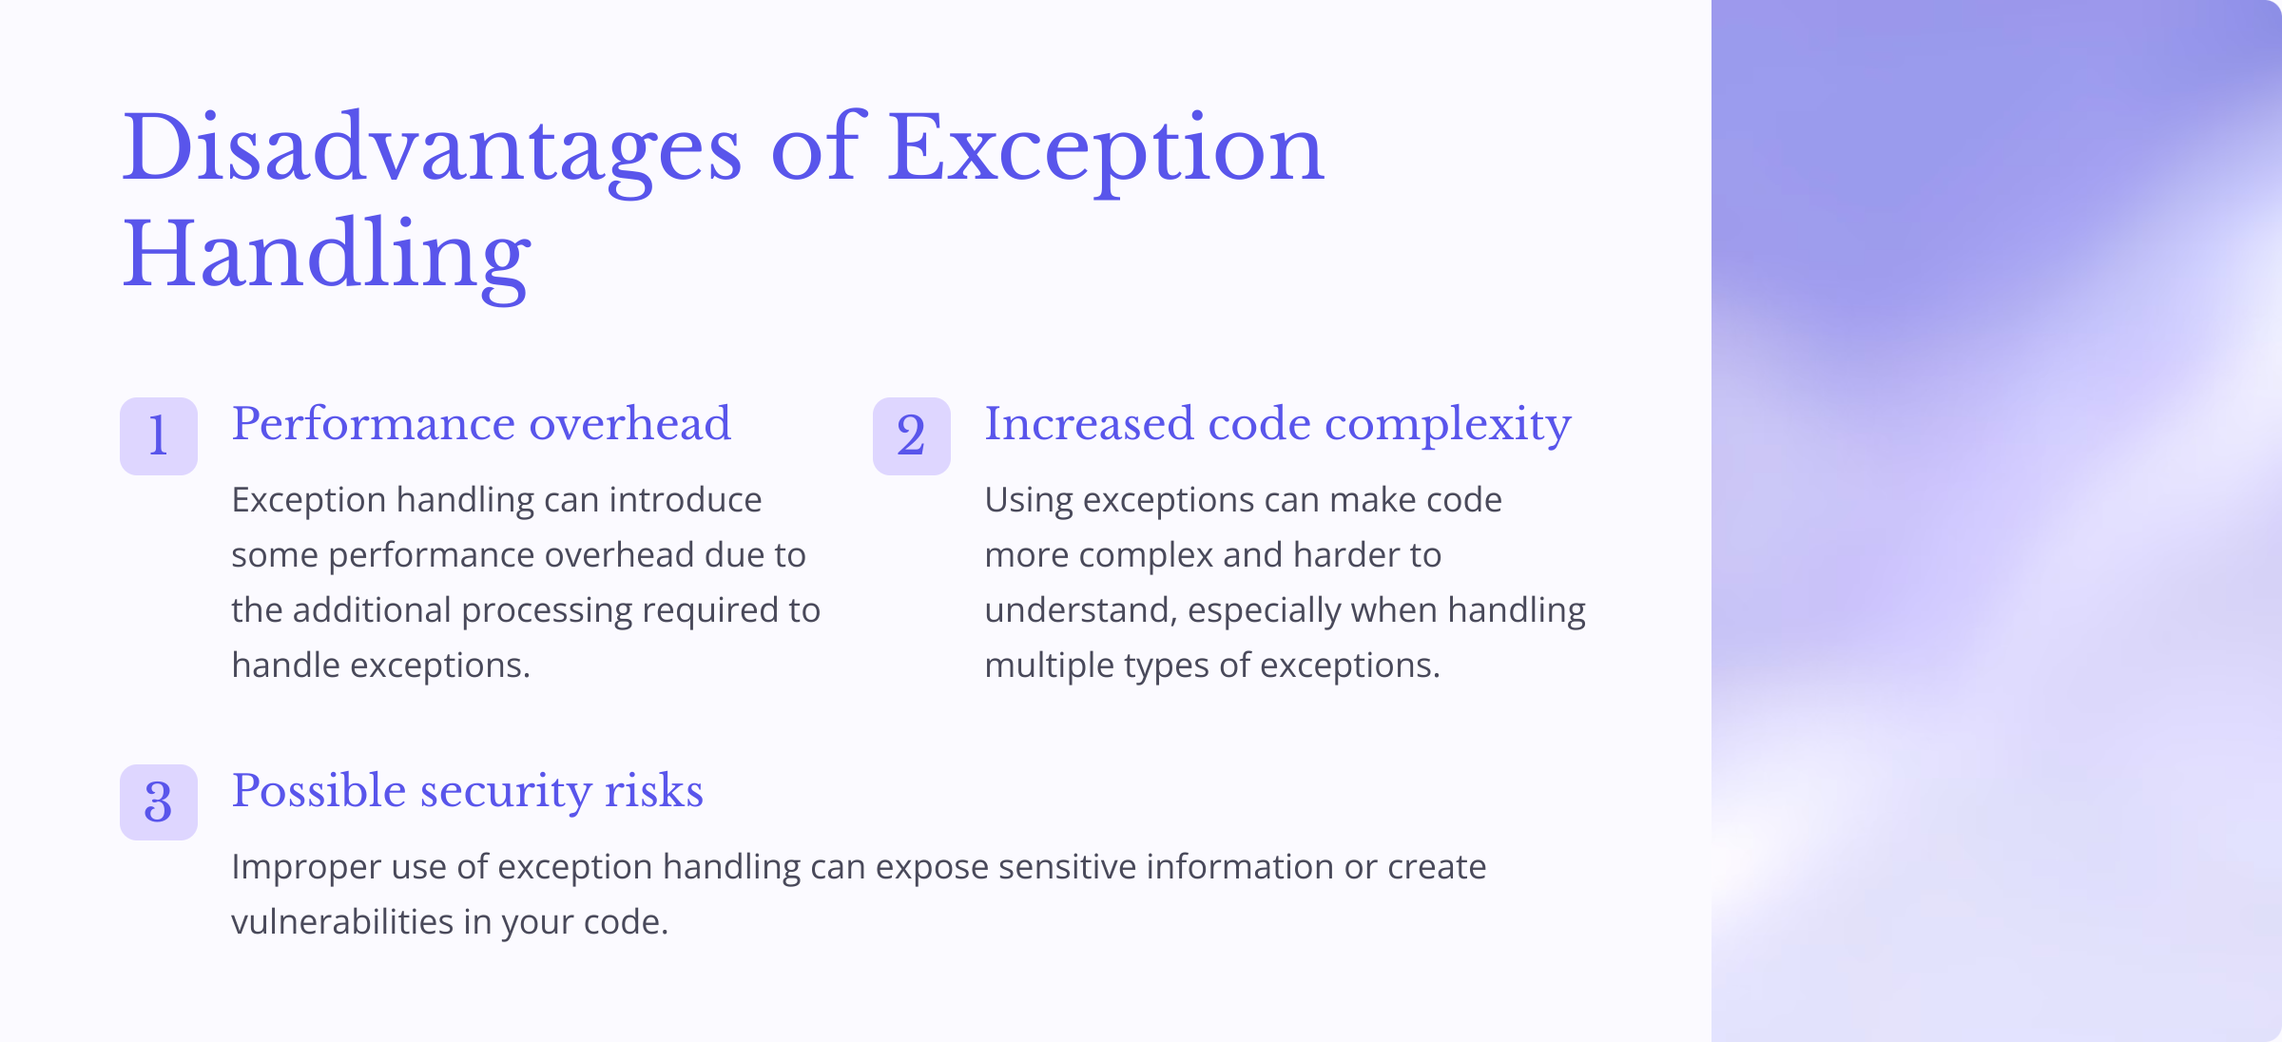

Slide 10
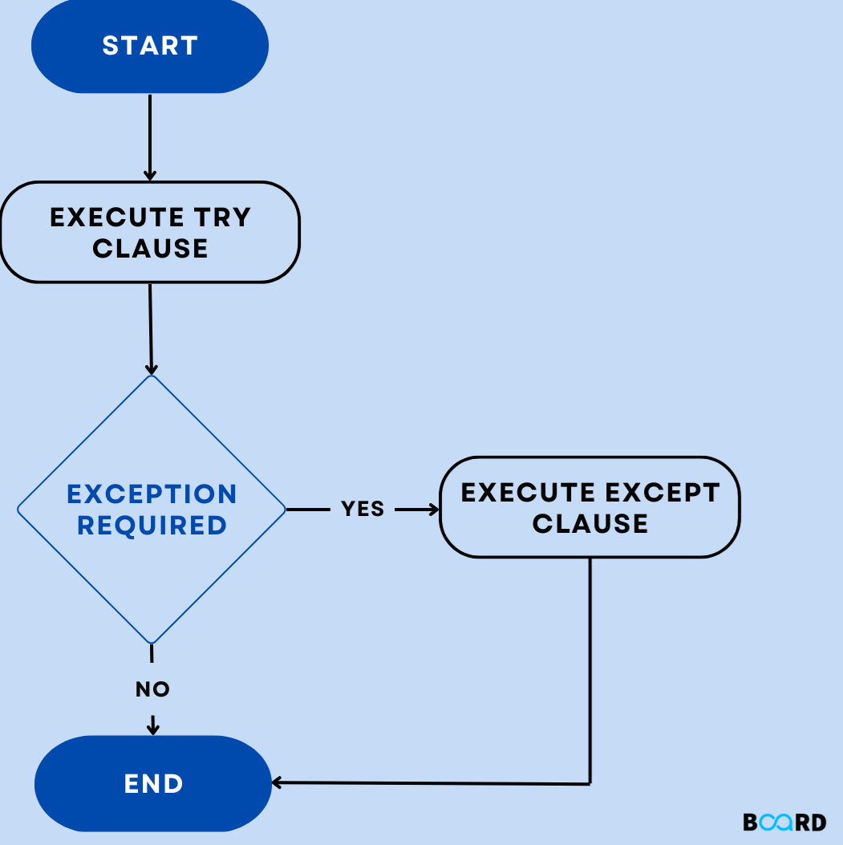
Possible Combination:Working
of ‘try’ and ‘except’
First try clause is executed i.e. the code between try and except clause. If there is no exception, then only try clause will run, except clause will not get executed. If any exception occurs, the try clause will be skipped and except clause will run. If any exception occurs, but the except clause within the code doesn’t handle it, it is passed on to the outer try statements. If the exception is left unhandled, then the execution stops. A try statement can have more than one except clause.

Slide 11
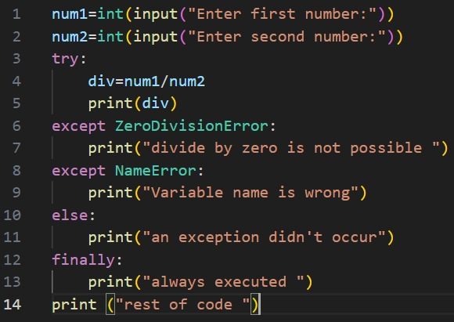
Example:

Slide 12

Searching
Searching refers to finding a specific element or value within a collection of data. Searching is the process of finding a particular piece of information or date from a larger set of data or information. There are various types of searching techniques, including linear search and binary search.

Slide 13

Linear Search Algorithm
A linear search is the simplest approach employed to search for an element in a date set. It examines each element until it finds a match, starting at the beginning of the date set, until the target element is located. If it finished and terminated once the target element is located. If it finds no match, the algorithm must terminate its execution and return an appropriate result. The linear search algorithm is easy to implement and efficient in two scenarios: 1. When the list contains lesser elements. 2. When searching for a single element in an unordered array.

Slide 14

Complexity of Linear Search Algorithm
Best Case
The element being searched may be at the best position in the array or not at all. In the first case, the search succeeds in 'n' comparisons. In the next case, the search fails after 'n' comparisons.
Worst Case
The element being searched may be at the last position in the array or not at all. In the first case, the search succeeds in 'n' comparisons. In the next case, the search fails after 'n' comparisons.
Average Case
When the element to be searched is in the middle of the array its called average case complexity.

Slide 15

Searching Algorithms: Complexity Analysis
When analyzing searching algorithms, we consider different cases that determine their complexity.
Best case: The search succeeds in 'n' comparisons if the element is at the best position.
Worst case: The search fails after 'n' comparisons if the element is at the last position or not present at all.
Average case: The complexity is determined when the element is in the middle of the array.

Slide 16
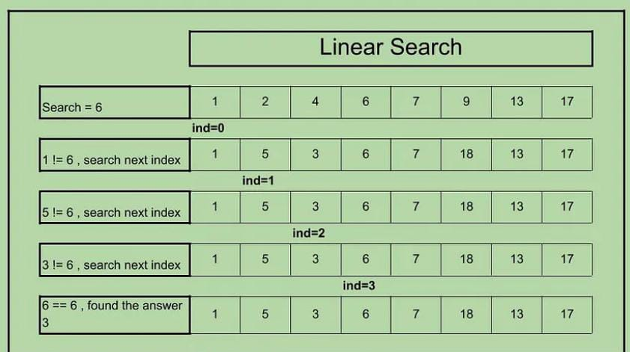

Slide 17

Binary Search
Binary search is an efficient algorithm for finding an item from a sorted list of items. In computer science, binary search is also known as half-interval search. Binary search compares the target value to the middle search compares the target value to the middle element of the array.

Slide 18
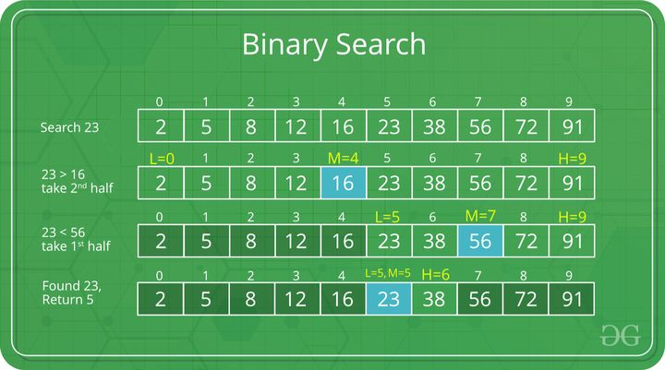

Slide 19



Binary Search Complexity
Time Complexity
The time complexity of binary search is O(log n), where n is the number of elements in the sorted array.
Space Complexity
For the binary search algorithm, the space complexity is O(1), which means it uses a constant amount of additional memory space regardless of the size of the input.

Slide 20
THANK YOU!!

